Slide 1
Deception Detection using Facial Action Units
Emanuele Orfanelli – Sapienza – Laurea Magistrale in Informatica AA. 2017/2018

Slide 2
Introduction
Deception Detection
Many ways to detect lies
FACS
AUs
Architecture
Dataset
Facial Landmarks
Extraction of Features
Action Unit presence/intensity
SVC
Result
Problems
Future
Thanks

Slide 3
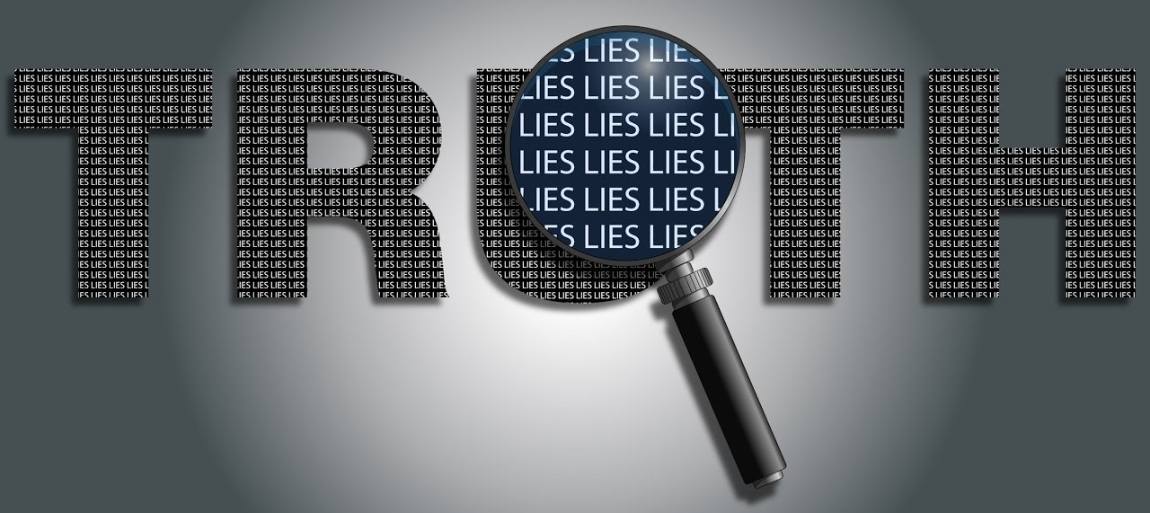
What is our goal?
Is it possible to recognize lies from truths?

Slide 4

There are many ways to detect lies
Psychology
Body language, micro-expressions, eye position
Speech analysis
Speed, patterns, words
Neuroscience
EEG, fMRI
Thermal Imaging
More….

Slide 5
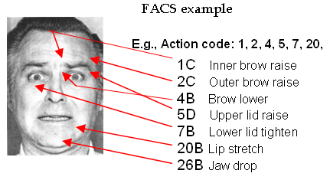
Action Units
Action Units (AU) are a contraction or relaxation of one or more muscles.
AUs can be used to codify emotions through the muscles involved and the intensity of the movement.
Facial Action Coding System manual for such classification.

Slide 6
Facial Action Coding System
Codify all AUs into expressions

Slide 7
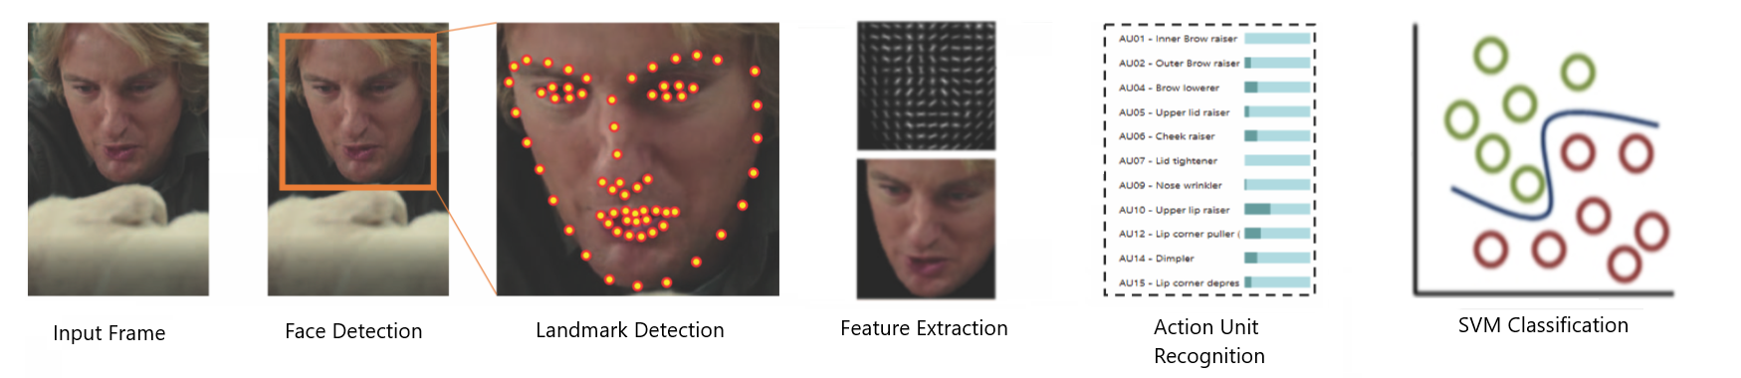
Architecture
Input Video
Face Detection
Landmark Detection
Feature Extraction
AU Recognition
SVM Classification

Slide 8
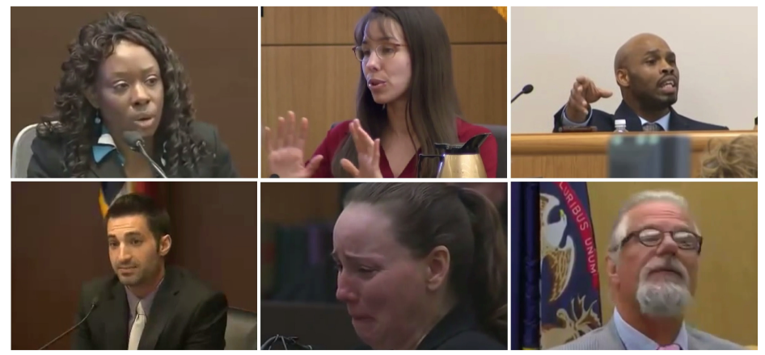
Video Dataset
Real life trial videos. High stakes.
121 videos.
61 deceptive.
60 truthful.
Defendant or witness can be clearly identified.
Three outcomes to label the videos as deceptive or truthful.
Guilty.
Non-guilty.
Exonerated (reversal of the sentence).
Testimony were verified by police officers.
Work on cutting and removing videos.

Slide 9
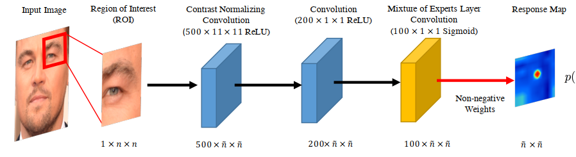
Facial Landmark Detection
Two Phases
Response map computation using Convolutional Experts Network
Shape parameter update
Convolutional Experts Constrained Local Model (CE-CLM)
Convolutional Experts Network as local detector
Computes a response map to accurately localize individual landmarks by evaluating the landmark alignment probability at individual pixel locations.
Individual landmark alignment is estimated independently of the position of other landmarks.
Constrained Local Model for shape parameter update
During the parameter update, the positions of all landmarks are updated jointly and penalized for misaligned landmarks and irregular shapes using a point distribution model
Control the landmark locations and to regularize the shape

Slide 10
Action Unit Detection
Trained on three dataset: ﻿DISFA, BP4D-Spontaneous and SEMAINE.
Datasets consist of videos of people subject to emotion inducing tasks.
﻿BP4D, SEMAINE and DISFA have three AUs in common: 2, 12, and 17.
SEMAINE and DISFA share AUs 2, 12, 17, 25.
BP4D and DISFA share AUs 1, 2, 4, 6, 12, 15, 17.

Slide 11
Action Unit Detection
Feature Extraction
Appearance Features: Histogram of Oriented Gradients.
Geometry Features: Landmark Location and Shape parameters.
Alignment and Masking
Need for a mapping to a common reference frame.
﻿Similarity transform from the currently detected landmarks to a representation of frontal landmarks from a neutral expression
Procrustes superimposition that minimized the mean square error between aligned pixels
﻿Masking is performed using a convex hull surrounding the feature points
Results in a 112x112 pixel image of the face

Slide 12
Action Unit Detection
﻿Appearance Features
12x12 block of 31 dimensional Histogram of Oriented Gradients are extracted.
4464 dimensional vector for the face.
PCA to get a vector of 1379 features.
Geometry Features:
Vector of dimension 227 from landmark locations and shape parameters
Total of ﻿1606 features that define the face.

Slide 13
Action Unit Detection
Action Unit Classification and Regression.
For AU occurrence detection Support Vector Machines.
For AU intensity estimation Support Vector Regression.
Linear Kernel in both cases.

Slide 14
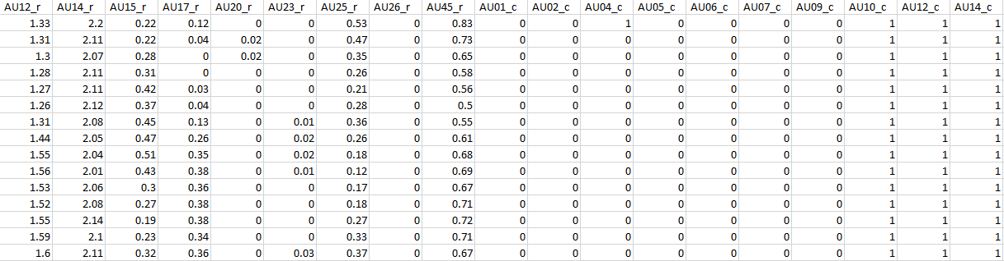
Deception Detection
Pre-processing of data:
Removal of all 0s rows
Presence Boolean 0 or 1
Intensity from 0 to 5
Three sets of data for analysis
Only presence
Only intensity
Together

Slide 15
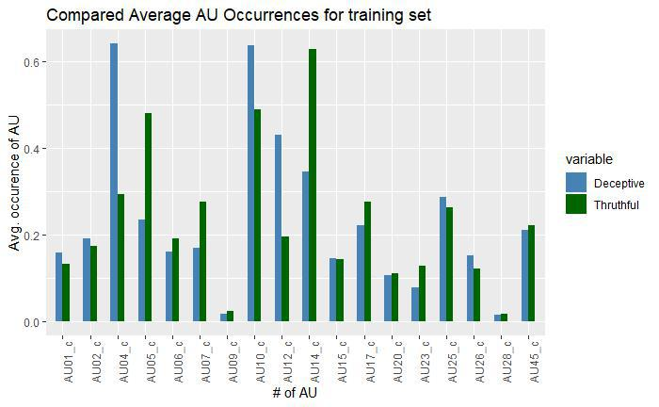
Deception Detection
Frequency Analysis of AU occurrences in the train set
Significant differences for truthful and deceptive in:
AU04
AU05
AU07
AU12
AU14

Slide 16
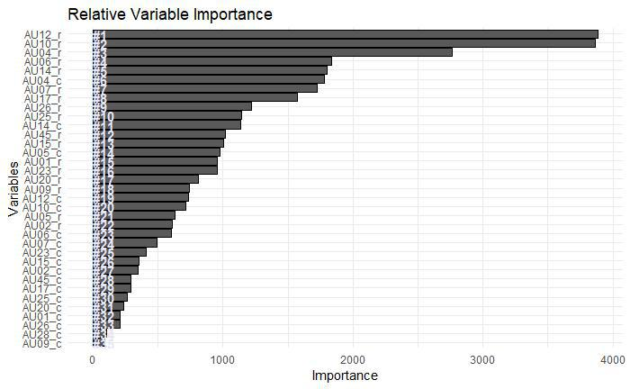
Deception Detection
Variable Importance using Random Forests

Slide 17
Deception Detection
Classification with Radial Basis SVM
72% accuracy on the test set

Slide 18
Results

Slide 19
Future Work
Bigger dataset containing videos of better quality;
Temporal information for Action Units using LSTM
Extend extraction to more than one person
Analyze interactions
Multimodal approach (thermal, body, words)

